Slide 1
The ML Landscape
Varol Kayhan, PhD

Slide 2
Agenda
What is machine learning?
Types of machine learning
Supervised, unsupervised, reinforcement learning
Machine learning essentials
Data set
Data partitioning
Machine learning challenges

Slide 3
What is Machine Learning

Slide 4
What is Machine Learning (ML)
Science (and art) of programming (making) computers learn from (historical) data
“The field of study that gives the computer the ability to learn without being explicitly programmed” (Arthur Samuel, 1959)
(Process of finding patterns and rules in large data sets (and using these patterns and rules to make predictions)

Slide 5
What is Machine Learning (ML)
Difference between ML and data mining (DM) / predictive analytics (PA)?
ML
DM/PA
Image recognition
Image classification
Reinforcement learning
Find patterns in 2-d data sets

Slide 6
When to use ML?
When problems are solved using rules that are:
In large numbers
Complex
Changing to changing conditions
Embedded in large amounts of data
Not all problems require ML:
Descriptive problems (what is happening)
Diagnostic problems (why is it happening)

Slide 7
ML "Mindset"
Anyone can "do" ML
Not everyone can "think" ML

Slide 8
Becoming a Machine Learning Expert
Handle large amounts of data?
Familiarity with statistics?
Knowledge of ML algorithms?
Interpret the results?
Analytical thinking?
Creativity?
Collaboration?
(Knowledge of ML tools/software)

Slide 9
Types of Machine Learning

Slide 10
Terminology
Value being predicted: Target, dependent, outcome, label, Y
Values used for prediction: Inputs, independents, predictors, features, dimensions, attributes, X
Two types of values:
Continuous, interval, numeric
Categorical, class
Nominal
Ordinal
Binary

Slide 11
Terminology
Regression task: predicted value is continuous (numeric)
Classification task: predicted value is categorical (binary or multi-class)

Slide 12
Supervised vs. Unsupervised Learning
 | Supervised Learning | Unsupervised Learning
Goal:
Outcome variable: (Y/N)
Data partition: (Y/N)
Data validation: (Y/N)
Example:

Slide 13
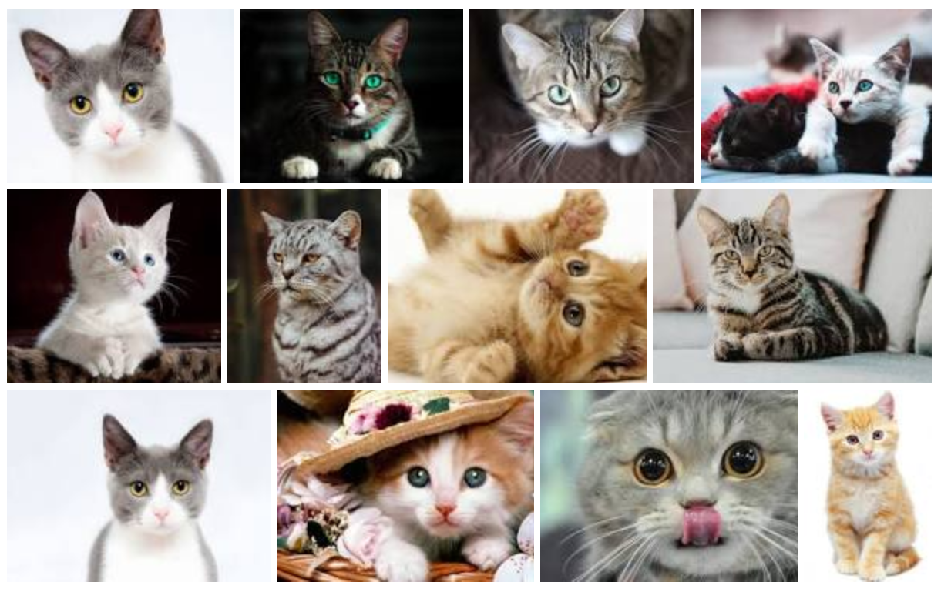
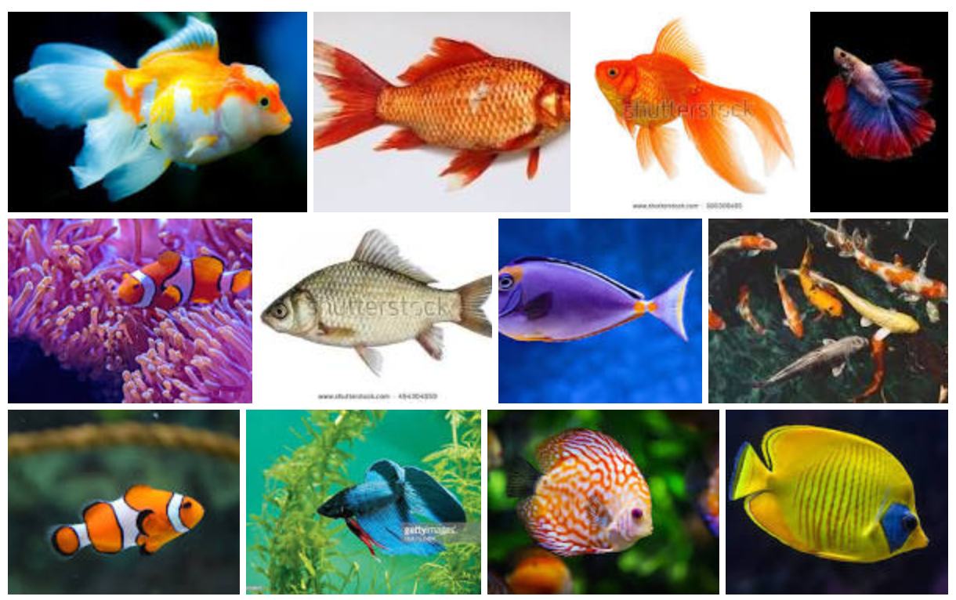
Semi-supervised Learning
I label one cat and one fish image.
The algorithm analyzes new images, and starts labeling others itself
Label: “cat”
Label: “fish”

Slide 14
Reinforcement Learning
Learning by doing
An “agent” performs actions to get “rewards” (or avoids “penalties”)
DeepMind’s AlphaGo player

Slide 15
Machine Learning Essentials

Slide 16
So Many Algorithms?!
Why are there so many algorithms?
Example: separate buyers from non-buyers
Age
Non-buyer
Buyer
Salary

Slide 17
Data Set
What does the (structured) data set look like?
ID | VAR 1 | VAR 2 | VAR 3 | … | VAR N
1
2
3
…
Which are the predictors?
Which is the outcome/target?

Slide 18
Data Set – Unit of Analysis
ID | Bedrooms | Bathrooms | Sq-Ft | Price
1 | 3 | 2 | 1700 | 150,000
2 | 2 | 1 | 1100 | 110,000
3 | 3 | 3 | 2000 | 170,000
… | … | … | … | …
What is your unit of analysis?
Room?
House?
Neighborhood?
City?

Slide 19
Data Set – Target/Outcome Variable
ID | Bedrooms | Bathrooms | Sq-Ft | Price
1 | 3 | 2 | 1700 | 150,000
2 | 2 | 1 | 1100 | 110,000
3 | 3 | 3 | 2000 | 170,000
… | … | … | … | …
What CAN BE your target/outcome variable?
Bedroom?
Sq-Ft?
Price?
Age?
Neighborhood?

Slide 20
Data Set-Exercises
What would the data set look like for learning/predicting:
Student GPA?
Whether a Facebook post is offensive or not?

Slide 21
Data Set
Why do I split the data into training, validation (and test)?
TRAIN
(60%)
VALIDATION
(40%)

Slide 22
Data Set - Partitioning
Evaluate the model "goodness:"
ID | Bedrooms | Bathrooms | Sq-Ft | Price
1 | 3 | 2 | 1700 | 150,000
2 | 2 | 1 | 1100 | 110,000
… | … | … | … | …
TRAIN
VALIDATION
ID | Bedrooms | Bathrooms | Sq-Ft | Price | Predicted Price
547 | 3 | 3 | 2000 | 170,000 | 180,000

Slide 23
Data Set - Partitioning
Model building approach:
For each different hyperparameter value:
Train the model
Validate the model
Select the model that has lowest error in validation Use the model on the holdout (test) set
Three splits:
Train (for building models)
Validation (for selecting the best model)
Test (for testing on truly “unseen” data)

Slide 24
Data Set - Partitioning
What if you have a small data set (can’t split into three):
CROSS-VALIDATION (i.e., 10 fold)
Find the best hyperparameters, use them to train on the whole data set.

Slide 25
Machine Learning Challenges

Slide 26
Challenges of ML
Irrelevant data
Incorrect “unit of analysis”
Insufficient data
Non-representative training data
Data quality (outliers, noise, missing values)
Underfitting
Overfitting

Slide 27
Underfitting vs. Overfitting
Avoid underfitting:
Change hyperparameters
Change algorithm
Feature engineering
Reduce model constraints (i.e., reduce regularization)
Avoid overfitting:
Change hyperparameters
Simplify the model
Reduce the number of epochs to train
Use model constraints (i.e., regularization)
Gather more data
Reduce noise in data

Slide 28
Conclusion
What is machine learning?
Types of machine learning
Supervised, unsupervised, reinforcement learning
Machine learning essentials
Data set
Data partitioning
Machine learning challenges

